Slide 1

“Department of Computer Engineering”
Micro Project on:
CRIME RECORD MANAGEMENT
Presented by:
Khushi Mehata (196019)
Khushi Asodekar (196036)
Guided By:- Prof. Dhaiwal sir

Slide 2
INTRODUCTION TO PROJECT
This is a project related to crime record . It is mainly use to store criminal record . As crime has increase in this digital world .To store the data of criminals . So it will become easy to fetch the data of criminals.
The proposed crime records management system can overcome the limitations of the existing system. The system provides proper security and reduces manual work .

Slide 3
CONTENT WE USED IN THIS PROJECT:-
GUI :-
Use (tkinter import*) for GUI
MessageBox widget module is used to display a message
Tkinter Label is a widget that is used to implement display boxes where you can place text or images
DATABASE :-
(import sqllite3) for database connection
Use of insert , select and update query to insert and update the information of criminal
Create query to create the table

Slide 4
FUNCTION:-
Toplevel () method is used when a python application needs to represent some extra information, pop-up, or the group of widgets on the new window.
destroy() method in tkinter is used to destroy a widget
grid(), place(), pack() to align the Button,Label and TextBox
Messagebox.showeinfo() and Messagebox.showerror() for dialogbox

Slide 5
WHAT WE HAVE USED IN THIS PROJECT :-

Slide 6
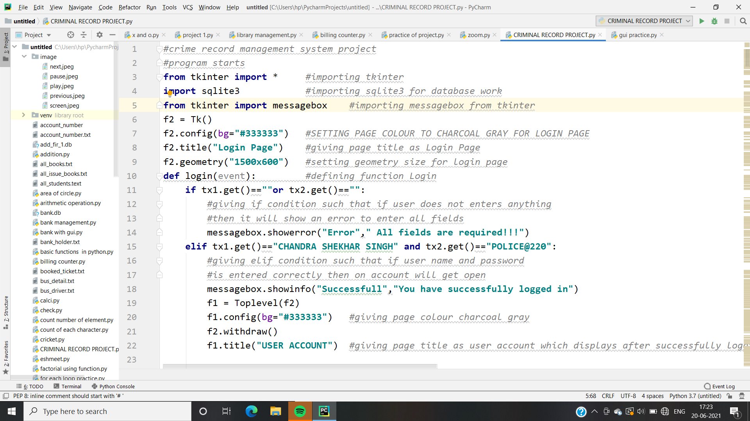
LOGIN CODE:-

Slide 7
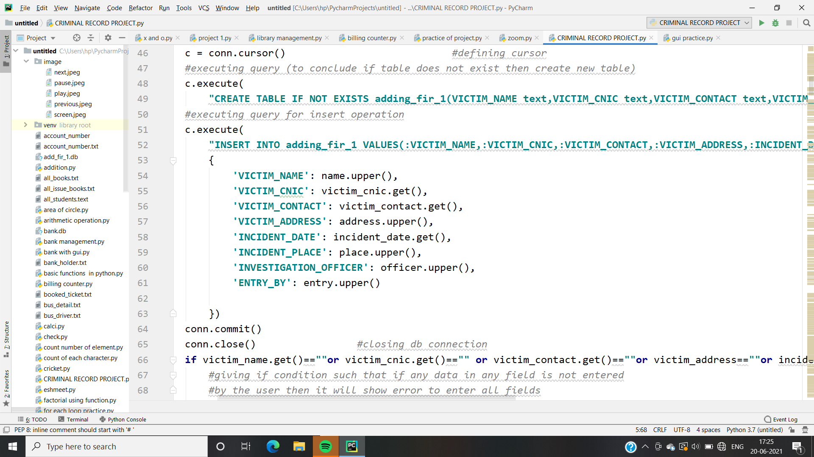
CREATE QUERY

Slide 8
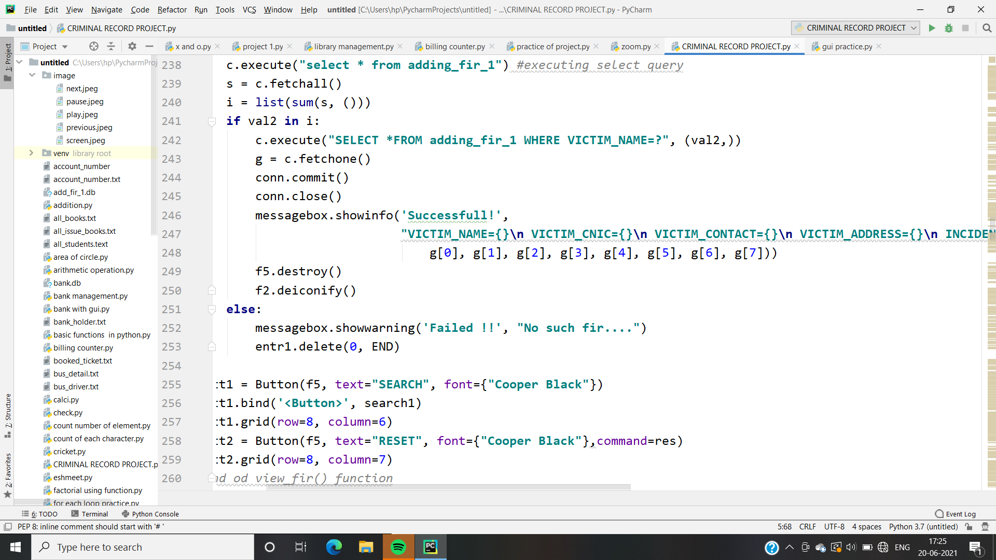
SELECT QUERY

Slide 9
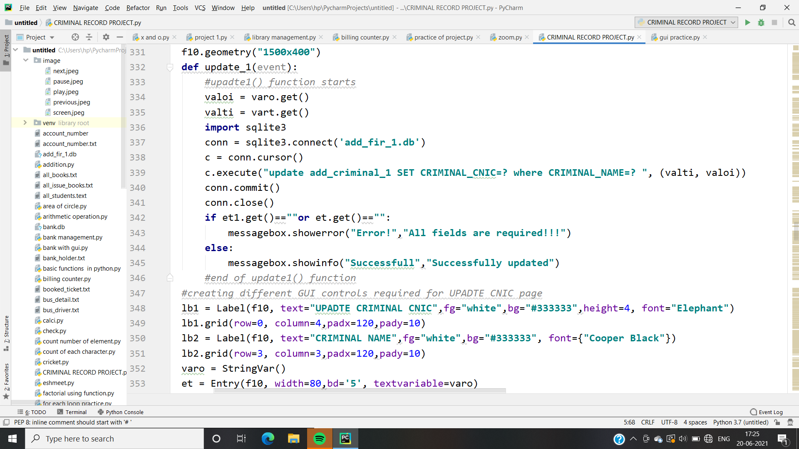
UPDATE QUERY

Slide 10
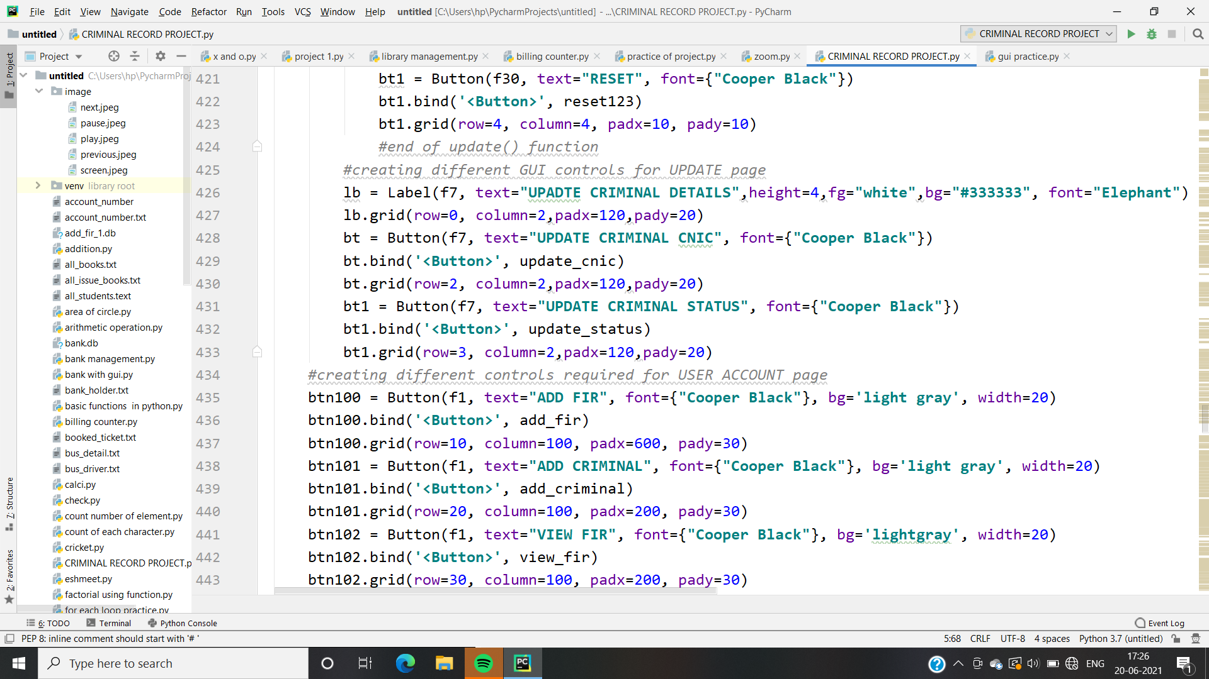
BUTTON IN GUI BIND WITH METHOD

Slide 11
PROCESS:-

Slide 12
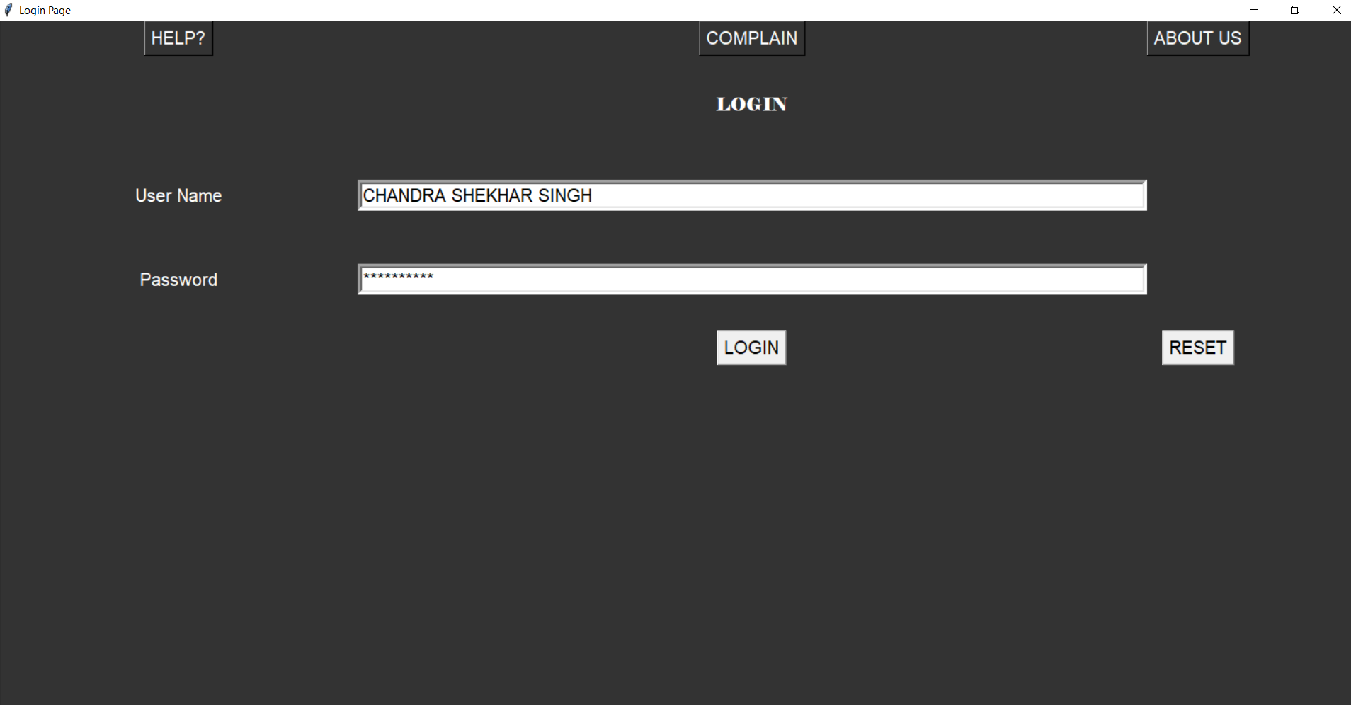
This project works to store the data related to criminals and view it as required while investigation. This is a login page to login . Username and password makes the project more safer so other cant login only user can login the project.

Slide 13
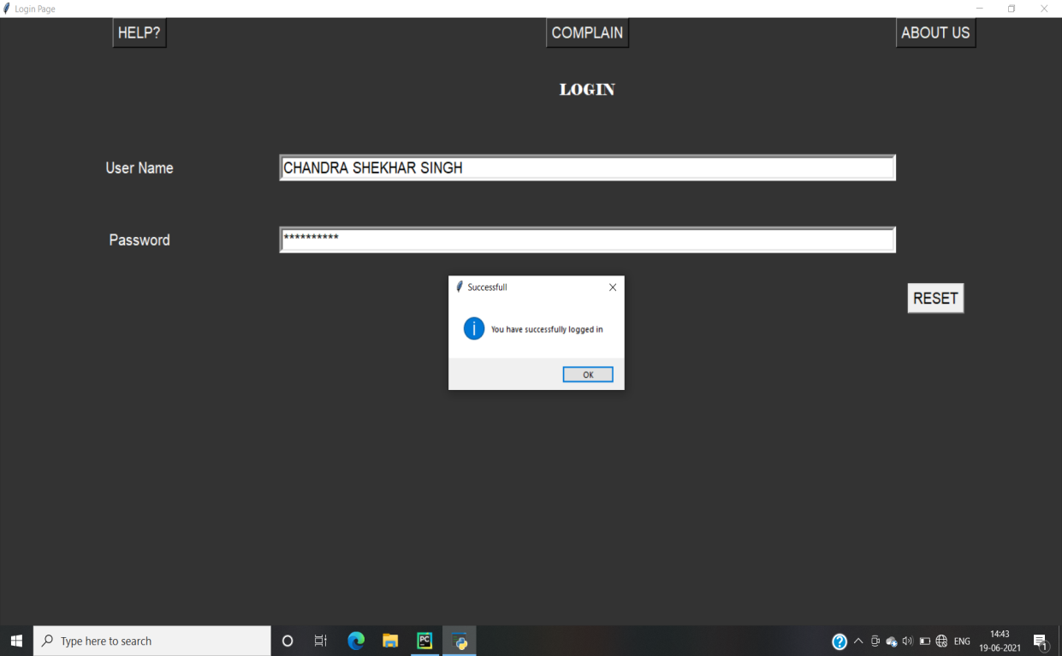
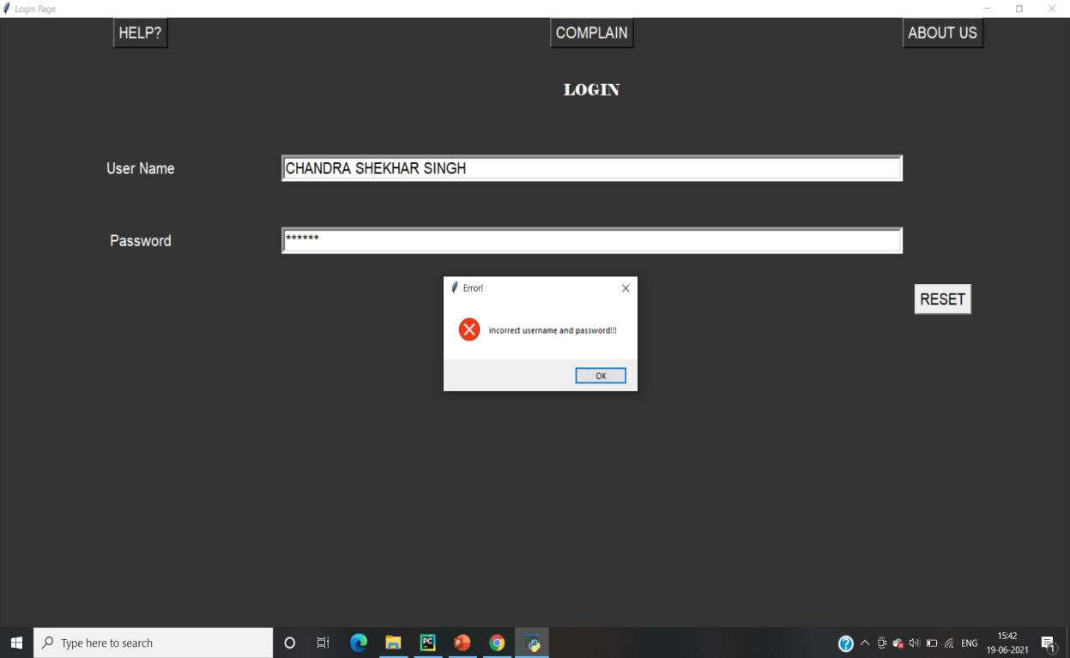
After login it checks the username and password and message of successfully login:-
If wrong username and password:-

Slide 14
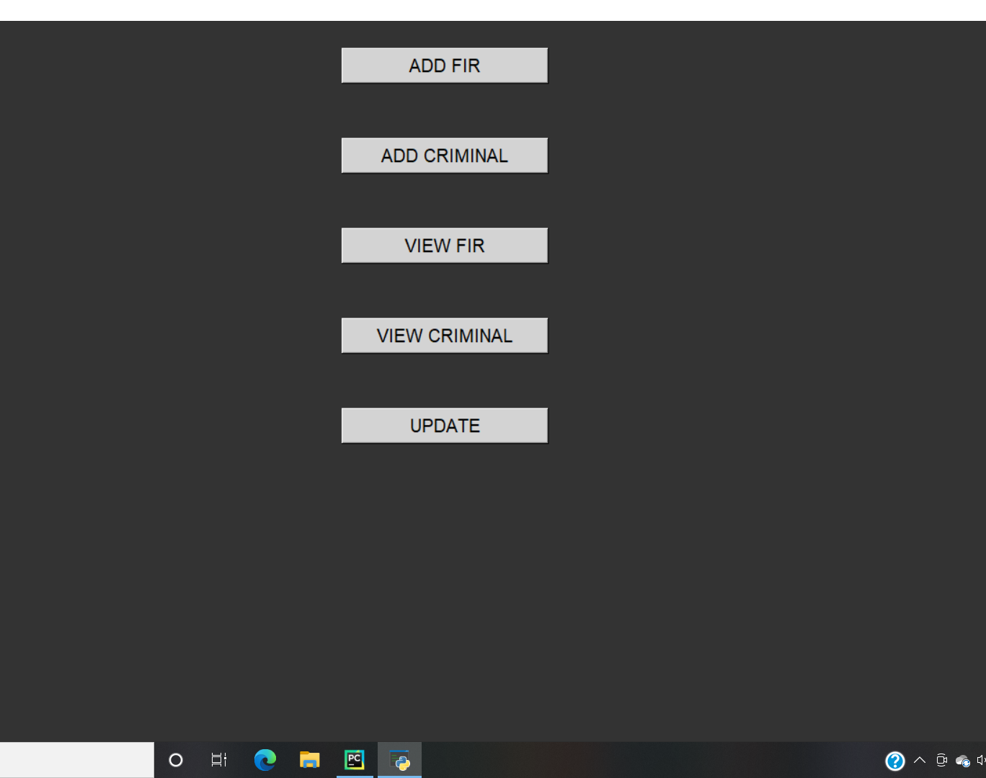
AFTER LOGIN PAGE
To add fir in records
To add the criminal data
3) To view fir in record
4) To view criminal record
To update the record
1
2
3
4
5

Slide 15
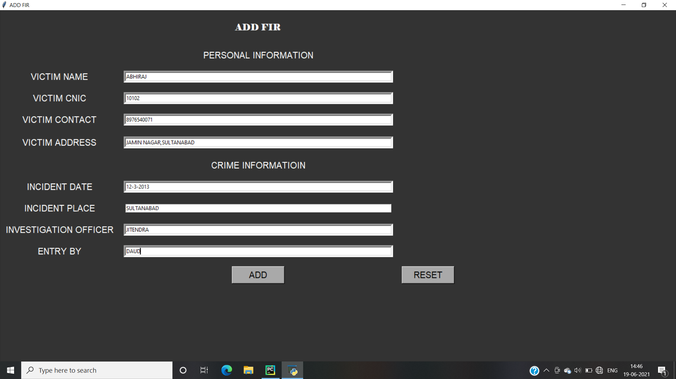
TO ADD FIR:-

Slide 16
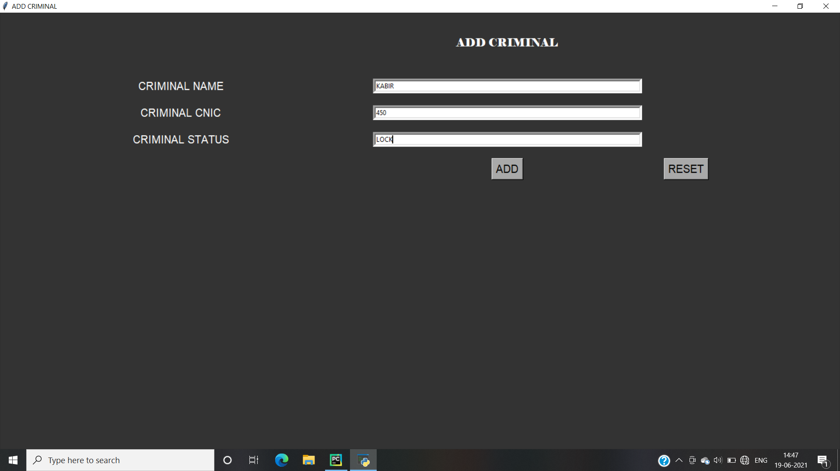
TO ADD CRIMINAL DATA:-

Slide 17
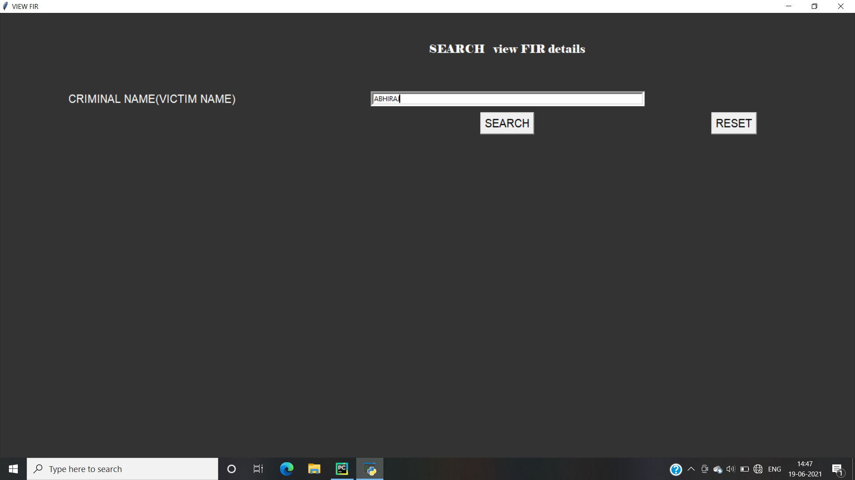
SEARCHING FOR FIR DETAILS:-

Slide 18
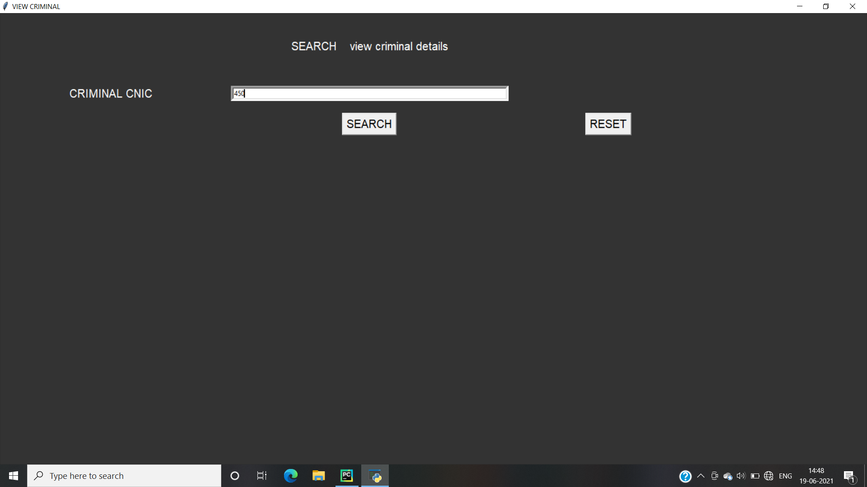
SEARCHING FOR CRIMINAL DETAILS:-

Slide 19
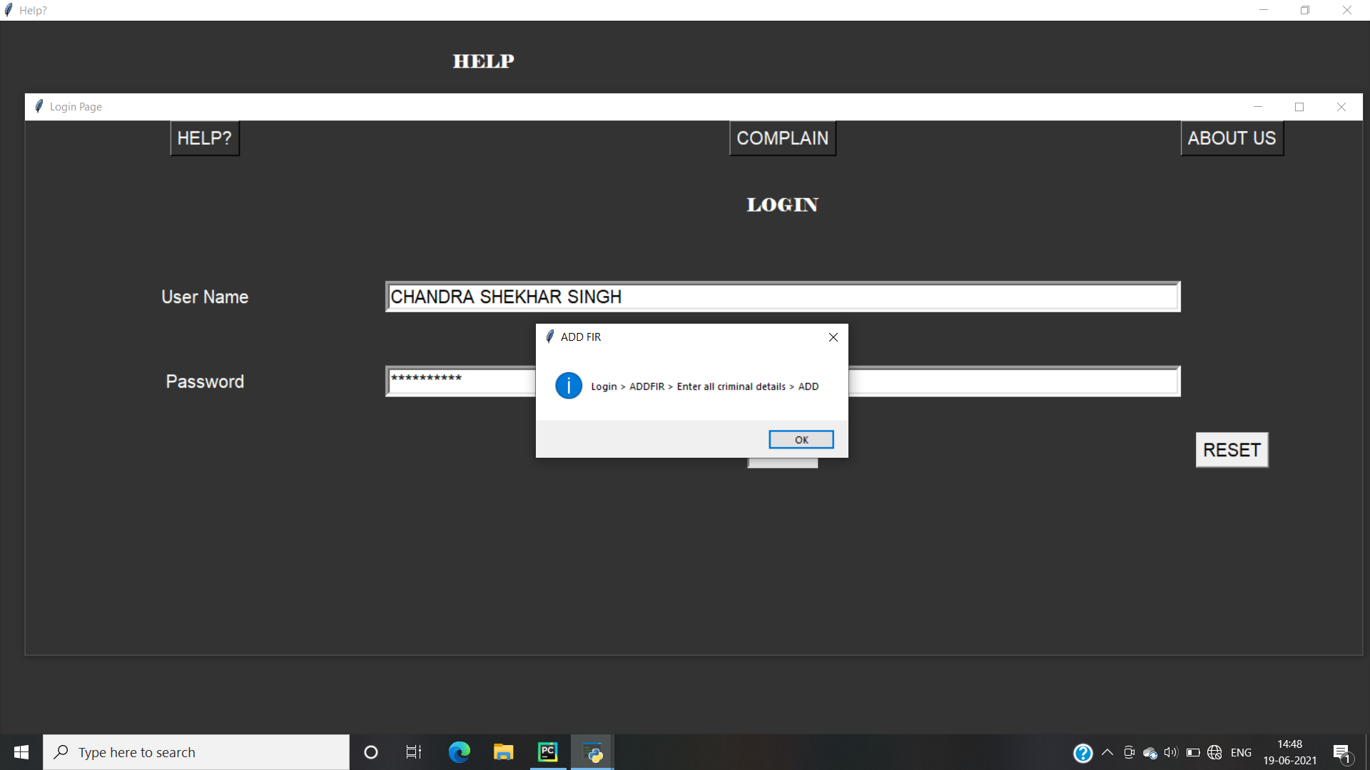
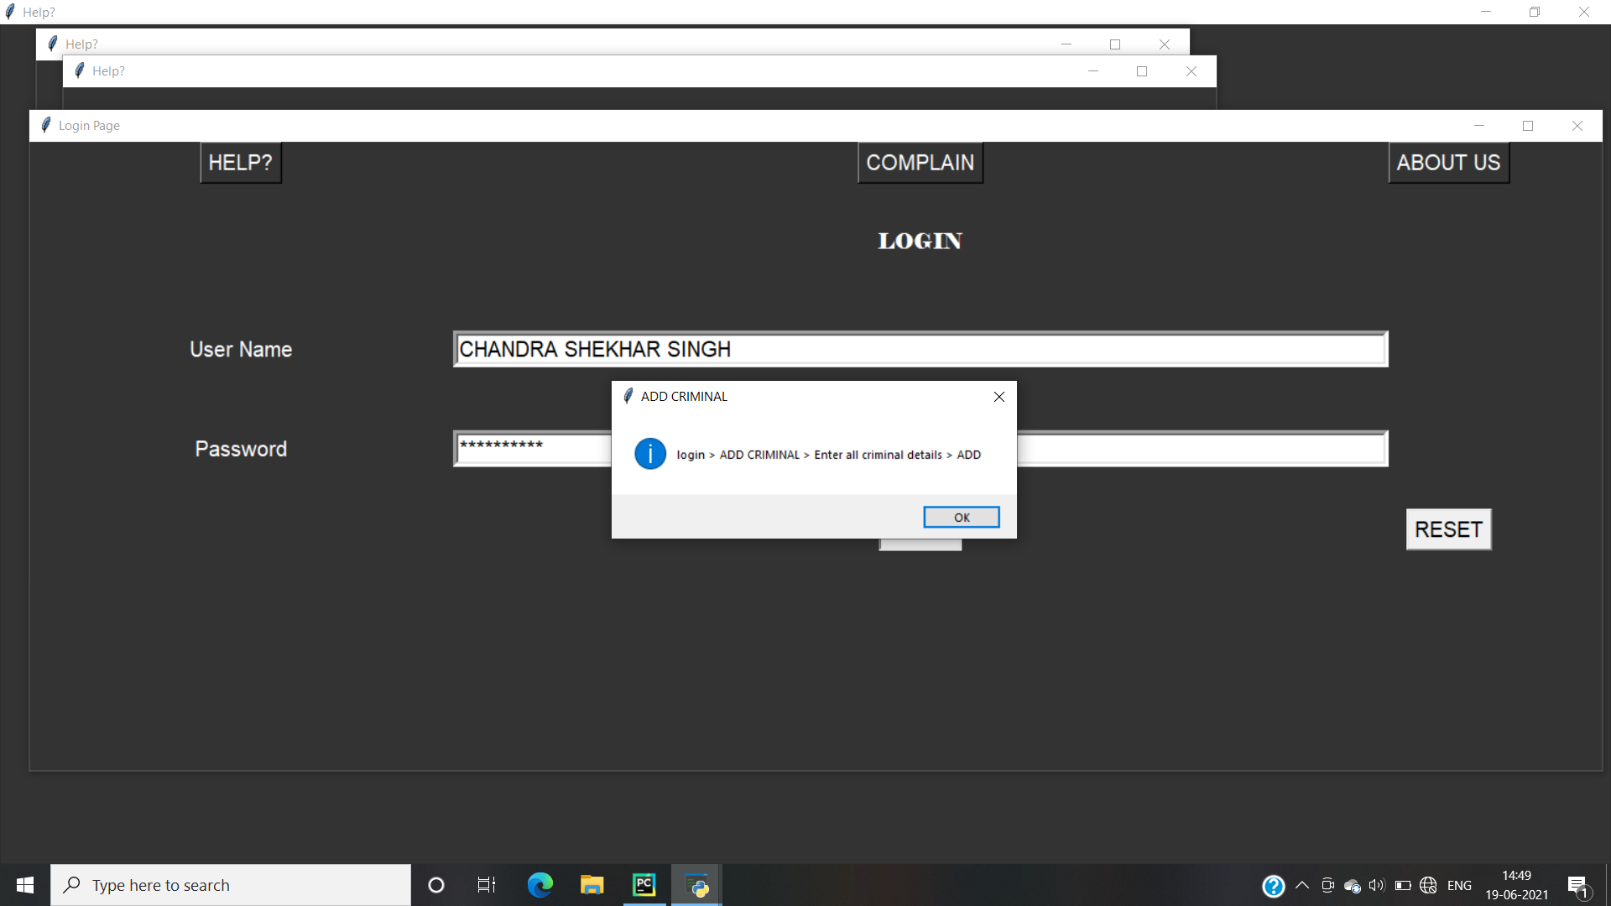
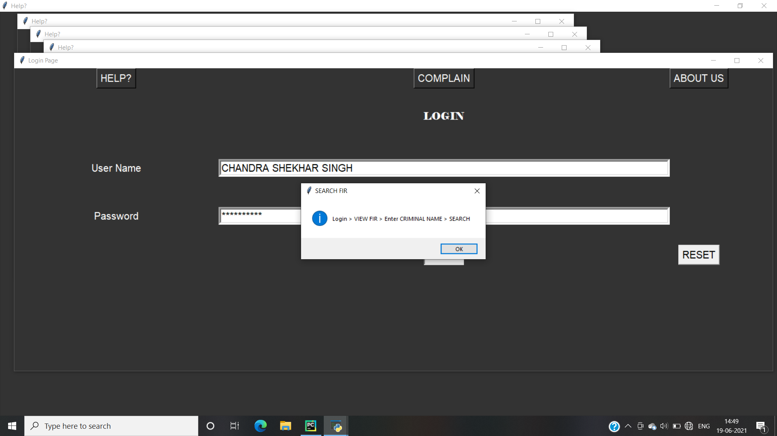
PROVIDE HELP TO ADD FIR
PROVIDE HELP TO ADD CRIMINAL
PROVIDE HELP TO SEARCH FIR

Slide 20
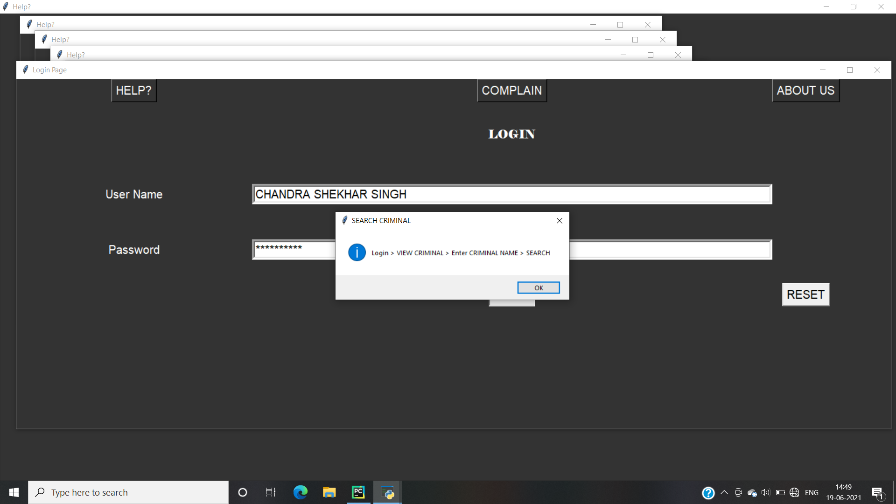

PROVIDE HELP TO SEARCH CRIMINAL
PROVIDE HELP TO UPDATE IN RECORD

Slide 21
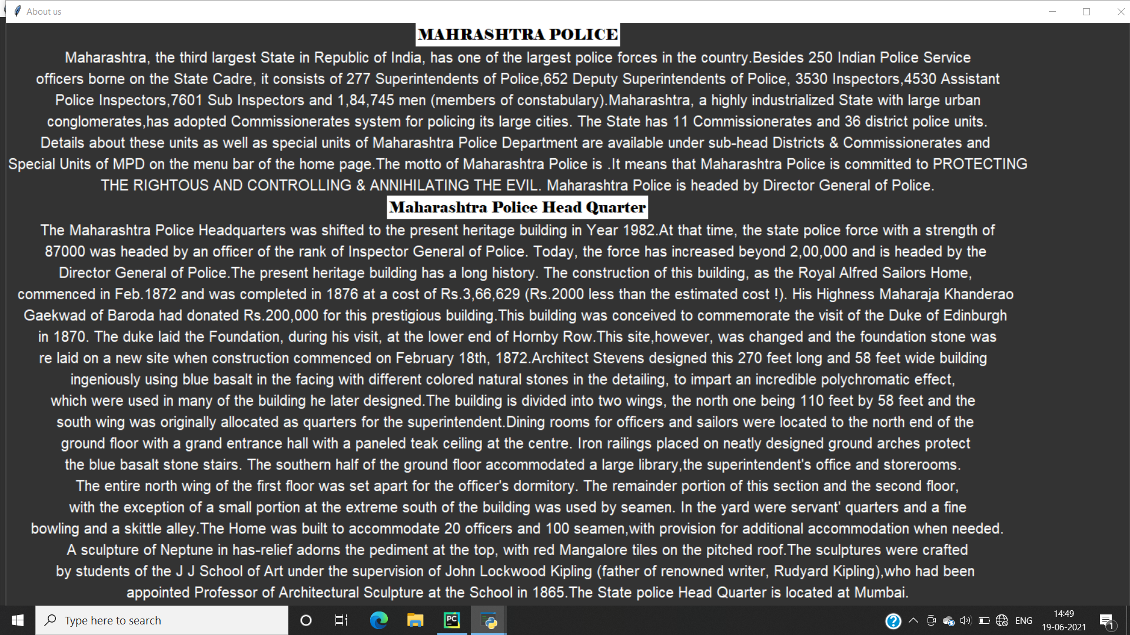
ABOUT CRIMINAL MANAGEMENT

Slide 22
THANK YOU !

